Slide 1
CIS 3710
SYSTEMS ANALYSIS
& DESIGN
Milestone 2

Slide 2
Kaitaia Publishing
Collective
Haris Khan, Konan Kouame, Ryan Horwitz, Christopher Luzzi, Benjamin Jackson

Slide 3
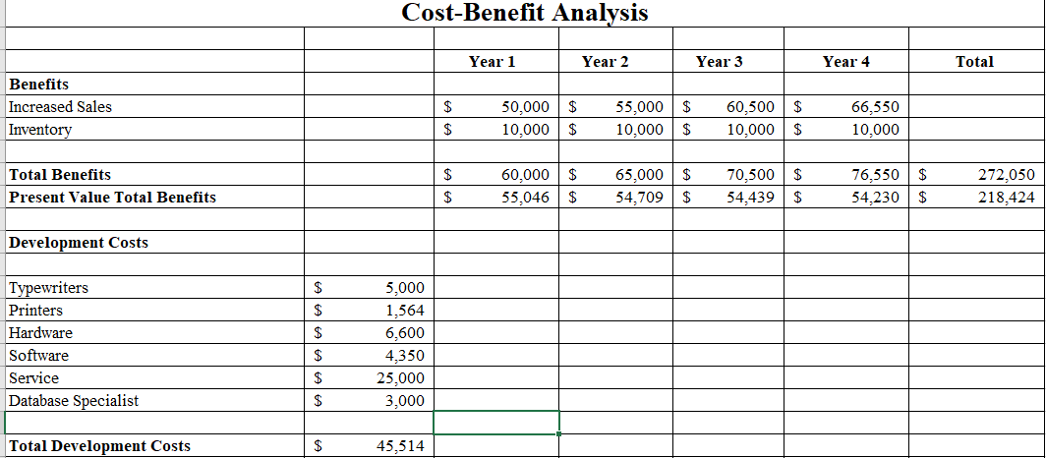
Cost- Benefit Analysis(Milestone 1)

Slide 4
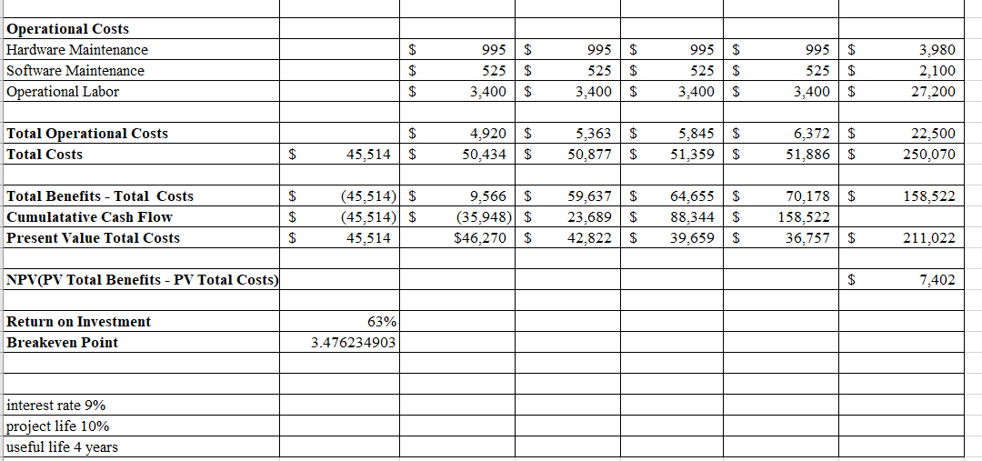

Slide 5
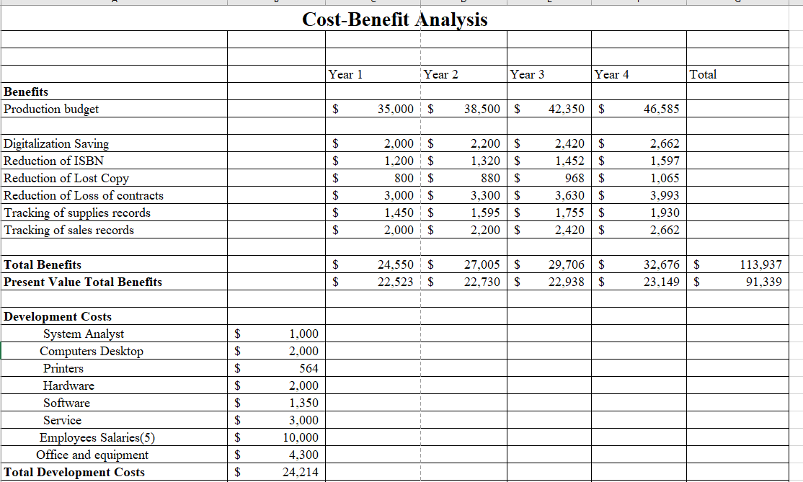
Cost-Benefits Analysis (Updated)

Slide 6
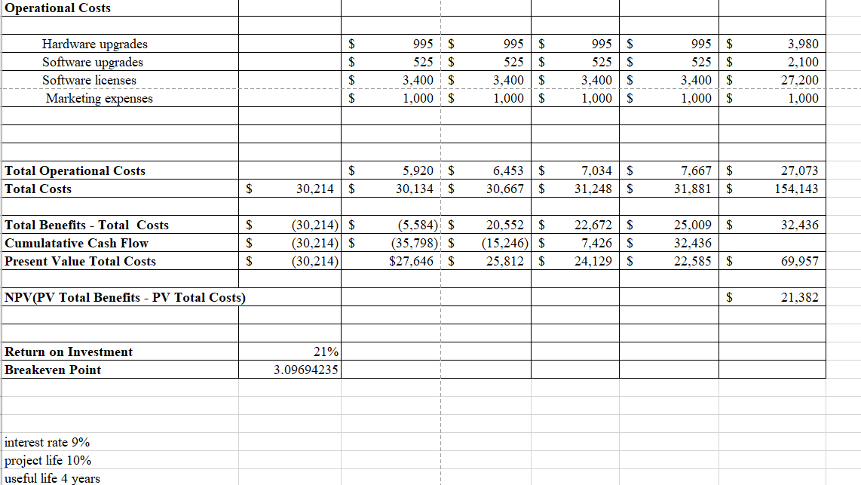

Slide 7
Project Size
Scope - The implementation of this system is vital in the growth of Kaitaia Publishing Collective. With our System in play Kaitaia will be able to correct errors and display significant improvements in budgeting and customer satisfaction.
Purpose - We will be creating a database to aid with error correction and prevention. This database will contain a detailed record of each document that Kaitaia has and will manage ISBNs to prevent mismatch.
Size - The project is a fairly sized project ranging in the small to medium range. The project will consist of 8 members that will be listed in the staffing estimation, but for generalization our team will consist of Systems analysts, computer technicians, database analysts, and a technology trainer.
Length - The length of this project will range anywhere from 3 months to 4 or more years.
Cost - The total cost for this project will roughly be around $154k-$155k for all four years.

Slide 8
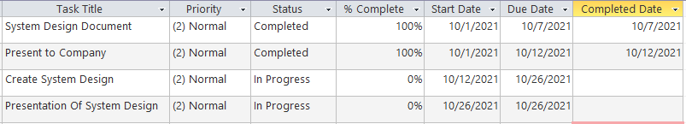
Work Plan

Slide 9
Staffing Estimate
1 Technology Trainer -------- One Year
2 Database Analysts -------- (Existing Employees)
2 Computer Technicians --- Outsourced Four(+) Years
4 Network Engineers ------- Length of Project

Slide 10
Risk Analysis
Implementation
Operation / Development costs
Benefits amount
Staffing
Hardware / Software

Slide 11
Thank You!

